Slide 1
Assignment 1(LMS)
15 marks (weightage 0 to 7)

Slide 2
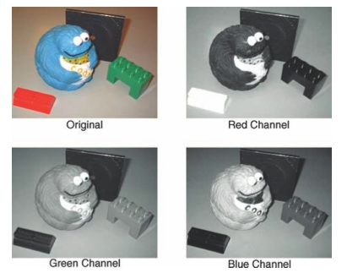
Question 1
starters
Choose an RGB image (Image1); Plot R, G, and B separately (Write clear comments and observations)

Slide 3
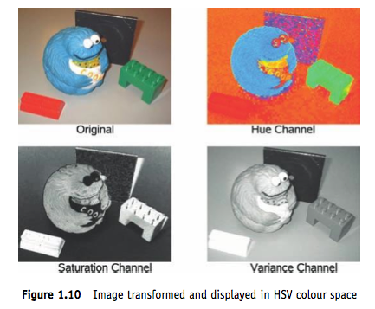
Question 2
starters
Convert Image 1 into HSL and HSV. Write the expressions for computing H, S and V/I.
(Write clear comments and observations)

Slide 4
Question 3
starters
Convert Image 1 into L*a*b* and plot

Slide 5
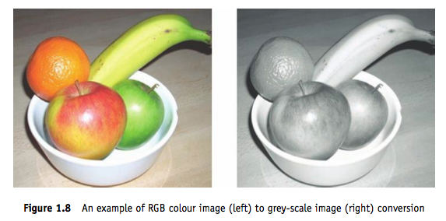
Question 4
starters
Convert Image 1 into Grayscale using the default OpenCV function. Write the expressions used for the conversion.

Slide 6
Question 5
starters
Take a grayscale image (Image 3) and illustrate
Whitening
Histogram equalization

Slide 7
Question 6
starters
Take a low illumination noisy image (Image 4), and perform Gaussian smoothing at different scales. What do you observe w.r.t scale variation?

Slide 8
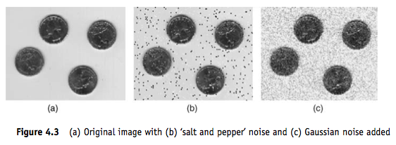
Question 7
starters
Take an image (Image 5) and add salt-and-pepper noise. Then perform median filtering to remove this noise.

Slide 9
Question 8
starters
Create binary synthetic images to illustrate the effect of Prewitt (both vertical and horizontal) plus sobel operators (both vertical and horizontal)
Clue: check when you have a vertical/horizontal strip of white pixels – vary width of the strip from 1 pixel to 5 pixels
What do you observe?

Slide 10
Question 9
starters
What filter will you use to detect a strip of 45 degrees

Slide 11
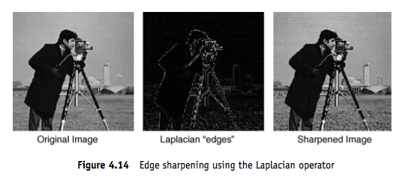
Question 10
starters
Take an image and observe the effect of Laplacian filtering
Can you show edge sharpening using Laplacian edges

Slide 12
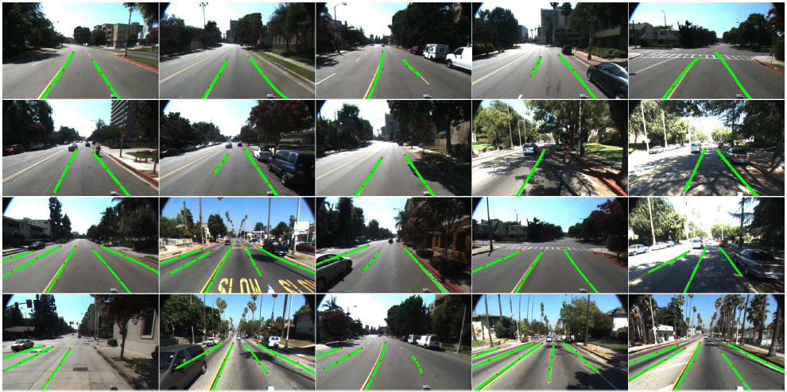
Question 11
main course
Detect Road land markers

Slide 13
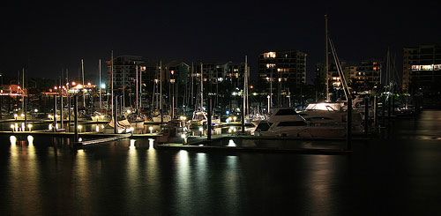
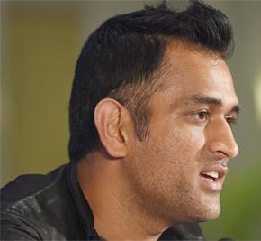
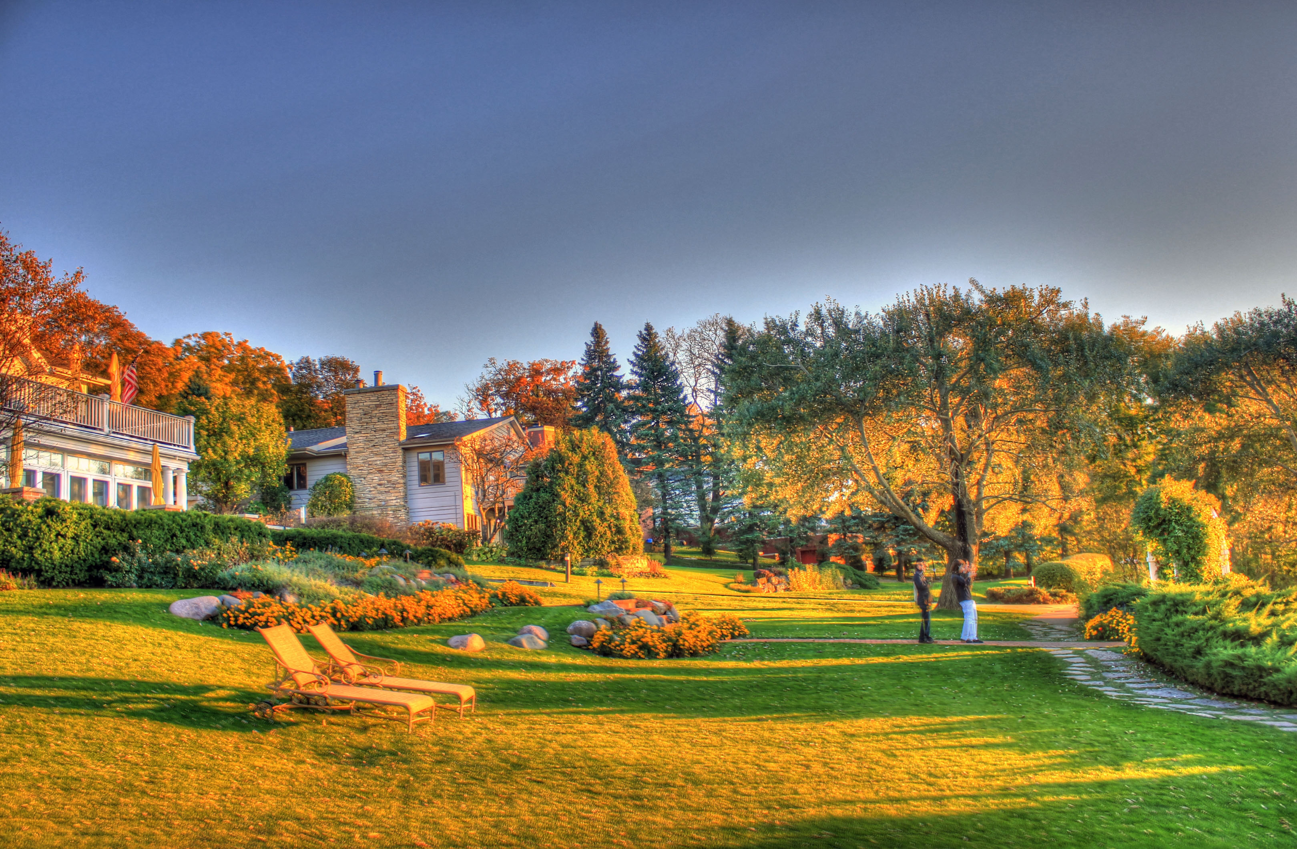
Question 12
main course
Classify modes:
Night; Portrait;
Landscape
Design features, use NN

Slide 14
Instructions
Write clear comments and observations
Submit a zip file with PDF, OpenCV code as well
Who submits? Team lead
Terminologies (Group = Team1, Team2); Group Lead, Team Lead (Team - Reporter; Coder)
Jan 26: Deadline for Team1 to submit to Team2 and LMS
Jan 29: Review Comments (report, code) to the partner pair and LMS (Write it better - what is not clear; Code it better)
Feb 1: Final submission on LMS

Slide 15
Next Few classes
Jan 19 class: 3:45 to 5:15 pm
Extra class: Jan 25 (Wed: 1:30 – 3:30)
Assignment 2 – Feb 2 class; ML starts Feb 2 class
Feb 2, 9, 16 classes => Mid Sem
OpenCV related queries
Neha.Tarigopula@iiitb.org; Praneeth.kumar@iiitb.org; (Python)
Chinchu.Thomas@iiitb.org; annapurna.sharma@iiitb.org; (C++)

